Slide 1


Module: CS103.3 Professional Development
K.K.Pavithra Subashini
Head / Senior Lecturer
Department of Computer Science and Software Engineering
Faculty of Computing

Slide 2
Ground rules
Interactivity is must
Proactivity is expected
No mobile phones during lecture
Allow access to digital devices during activities
Activity based learning

Slide 3
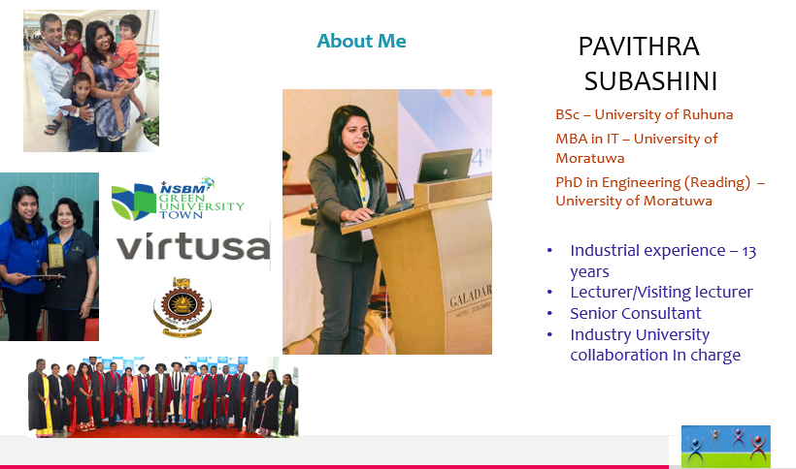
Self Introduction

Slide 4

Do you know yourself?
What I want to do?
Who am I?
What am I doing?
Am I on the right path?
What do I love in my self?

Slide 5


Reasons to get to know Yourself
You will discover something that you don’t know about yourself
You will know where your moods, attitudes and belief begins and other people’s stop
You will notice more than you imagine about the rest of the world
You will be more happy
You will find yourself on track to getting what you want

Slide 6


Getting to Know Yourself
Describe yourself!
Write down what you look like
Where you live
Where you went to school
Include things you like to do
What is your future plan?
Add anything else you think is important about you.

Slide 7
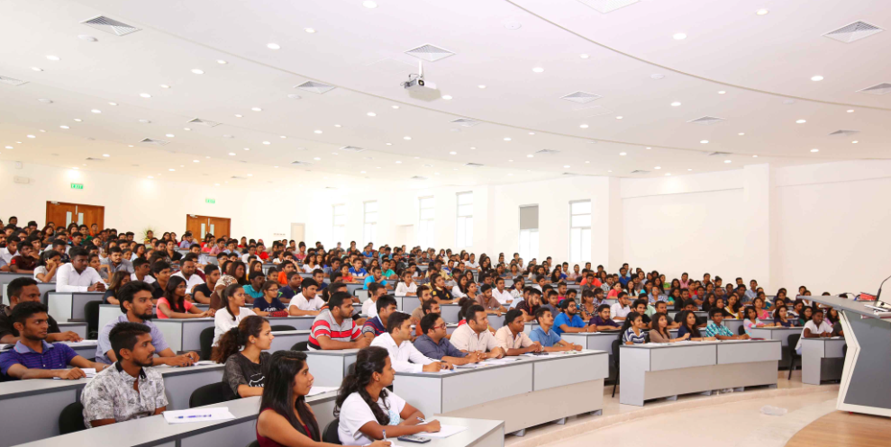
Know your batch

Slide 8
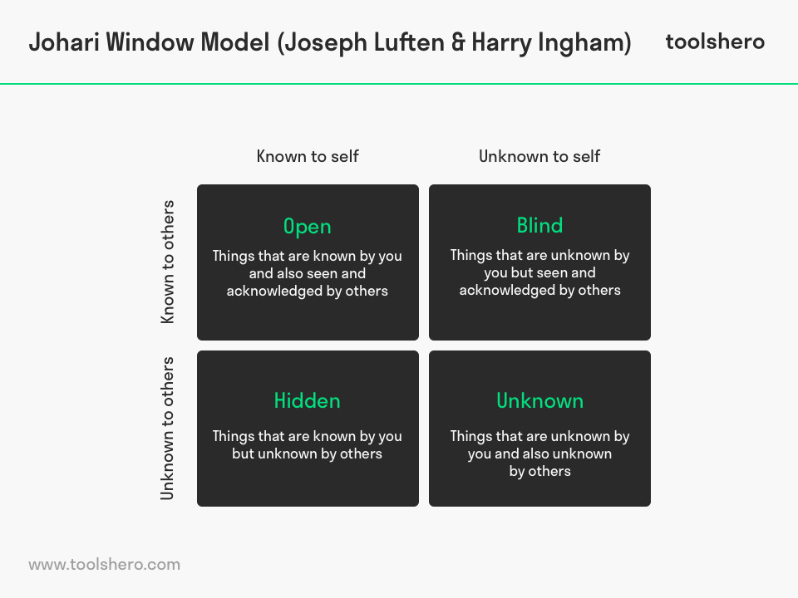
Johari Model
The Johari window is a framework developed by two psychologists named Joe and Harry as an aid for understanding the self.

Slide 9

Johari Model
One room is open. This represents things that both you and others know about you. For example, this might include your job title, your hair color, and so on. You might say this is the “public” you.
Another room is hidden. This represents things you know about yourself that others don’t know. This might include feelings that you don’t share, or other things you conceal from others. This is the “private” you.
The last room is your blind spot. This represents the things that others can see about you, but that you are unaware of. Maybe people see you as self-assertive person but don’t tell you. This is the public self that you are unaware of.
Another room is unknown. This represents the things that you don’t know about yourself, and neither does anyone else. You may have feelings that you are not aware of, or you may be capable of things you don’t know you are capable of. This is the “unknown” you.

Slide 10
What is your vision?
“ Personal vision is the ultimate goal you want to achieve in your life. Your personal vision statement guides your life and provides the direction necessary to chart the course of your days and the choices you make.”

Slide 11
Example-Personal vision
‘ to be a successful character’
‘ keep happiness for my life’
‘ be a helpful person to the associates’
‘ most popular character in the country/world’
………………………………..

Slide 12
How to write a personal vision statement
Project 5 to 10 years in the future.
Dream big and focus on success.
Use the present tense.
Use clear, concise language.
Infuse your vision statement with passion and emotion.
Areas that you can focus on your vision statement are; Health, Ability, Relationships, Time, Wealth, Experiences, Accomplishments and contentment.
Examples
My personal vision is to have a life of meaning for myself and others. It is important to me to live my life in a way that shows kindness, care, and concern for family and friends and even strangers. Earn respect for myself based on a recognition of my accomplishments and abilities, maintains a sense of appreciation of the beauty of nature, and a sense of humor.
My career goal is to become a doctor working in a large hospital. I’ve always wanted to help people live healthy lives and cure illnesses.
I want to work with young people in the community as a social worker. My talent as an approachable person and my strong commitment to justice have inspired me to assist others who are less fortunate.
My career goal is to become the CEO of a technology company. I am driven by technology’s ability to affect global communication and dedicated to providing technological solutions to empower underrepresented populations.

Slide 13
Personal Objectives
“An objective is a short statement that clarifies your goals. It is the steps that you can take to achieve your vision.”
There are short term objectives and long-term objectives.
Examples
Following a challenging career in an organization to the growth of which I can contribute with my skills and competencies, while gaining incomparable experience for the betterment of my career.
My ultimate objective is to utilize my academic knowledge together with my skills to be in the highest position in an Accounting & Finance field, after gaining the relevant professional qualification and all the around experience and play vital role in the success of the organization
Self motivated and highly organized individual with a pleasant personality possessing good interpersonal communication skills. An undergraduate who is highly focused on reaching towards goals and ambitions in life.

Slide 14
Four Squares
5 years ago
1 year ago
1 year from now
5 years from now

Slide 15


What do you want to achieve?
What do you need to achieve your objectives?

Slide 16
How do I get there?
What do I have to identify?
Strengths
Weaknesses
Environment
Barriers
Support systems

Slide 17
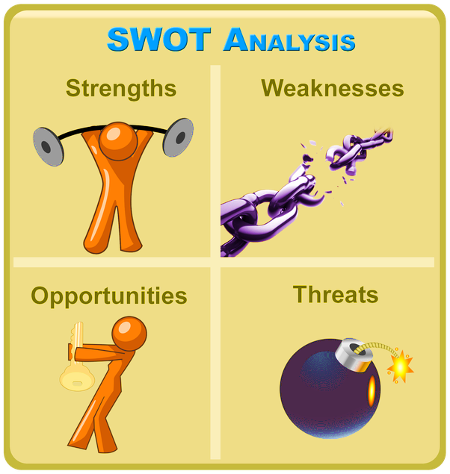
SWOT Analysis

Slide 18
SWOT Analysis
“ A SWOT analysis generates information that is helpful in matching an individual’s, organization’s or a group goals, programs and capacities to the social environment in which they operates”

Slide 19
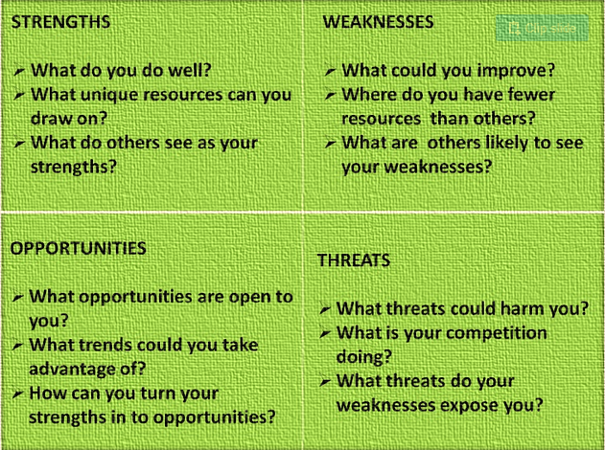

Slide 20
For a productive SWOT
Stay focused
Be specific and avoid gray areas
Keep SWOT short and simple
Avoid complexity and over analysis

Slide 21
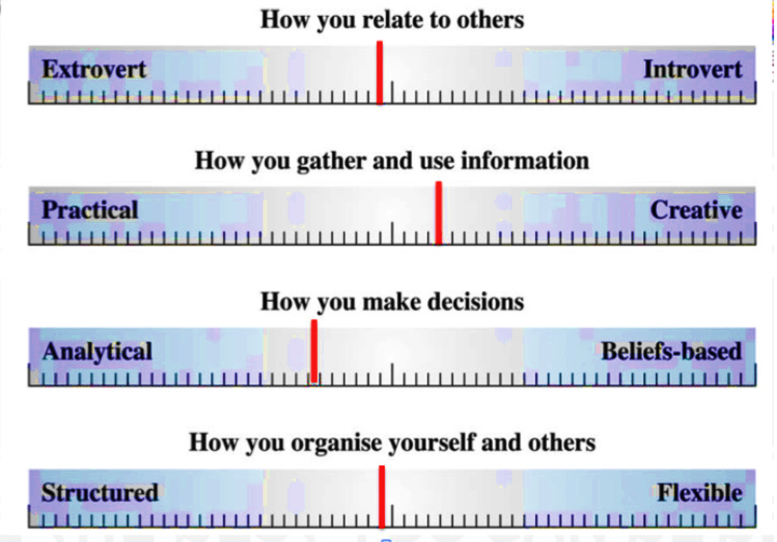
RIDO Scale of Self Assessment

Slide 22

Let’s Introduce Ourselves!!

Slide 23
Let’s Introduce Our Friends!!

Slide 24


